Slide 1

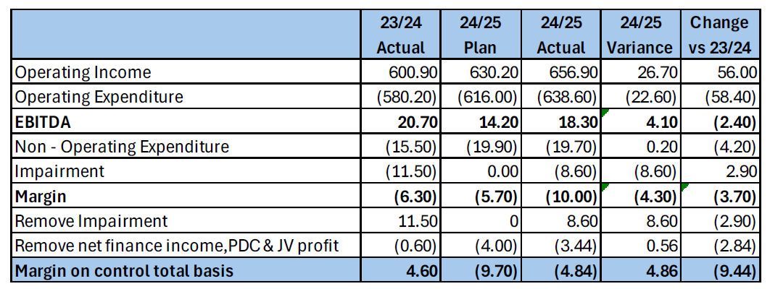
2024/25 Financial Position
  Deficit plan in year of £9.7m
  Better than plan in year by £4.9m
  R&D and Education activities continues to improve
  Pressures on non-pay continue

Slide 2
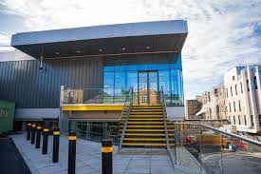
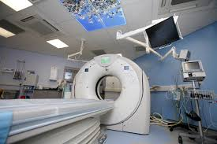
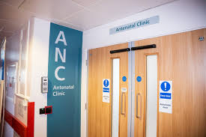
2024/25 Capital Position
  Another good year with total spend of £46.4m
  Additional £5.3m on medical equipment
  Hand Surgery unit
  Continued Digital investment
  Next year we’ll spending even more

