Slide 1
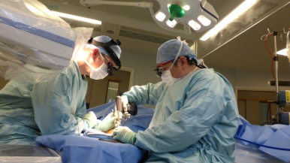
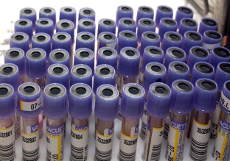

Mel Pickup Chief Executive Annual Report 2024/25

Slide 2

2024/25 - Our year in numbers
Served a diverse population of around 667,000
Trust income: £656.9 million
Employed over 7,637 members of staff
520,626 outpatient appointments
Delivered 5,283 babies
Performed 18,336 operations
147,534 attendances at A&E

Slide 3


NHS Trust league tables
NHS England launched a new dashboard providing a view of how trusts are performing. We were:
Ranked in the top third of NHS trusts nationally
The best scoring trust in West Yorkshire
Ranked 37 out of 134 acute trusts.
In the most recent iteration of the league table, our position reduced slightly to 40, but we remain within the top third nationally.
If our rating was based purely on operational performance, we would have been in segment two and our position would have been 24 out of 134 acute trusts. However, any organisation with an underlying financial deficit cannot be allocated to a segment higher than three.

Slide 4
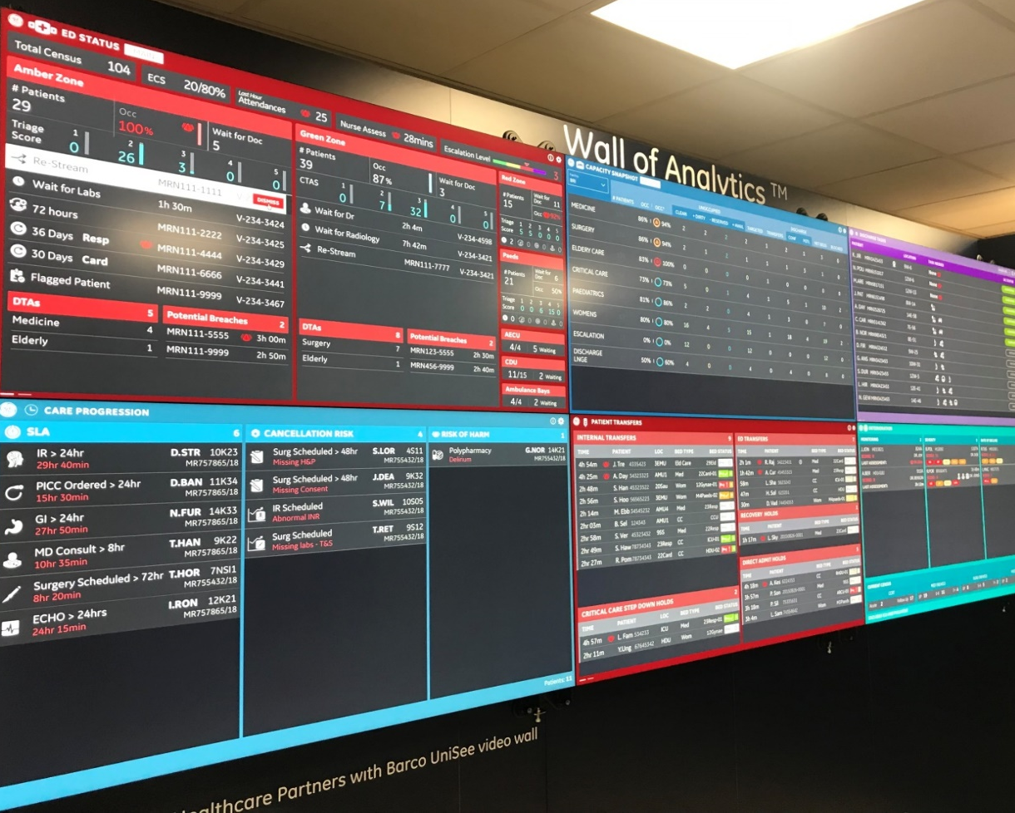
Performance Overview 2024/25
Our performance is measured in many different ways, but there are a smaller number of key measures relating to specific waiting times. For those, our performance is measured against indicators in four areas:
Cancer waiting times
Emergency care standard
Referral to treatment waiting times (RTT)
Diagnostic waiting times

Slide 5
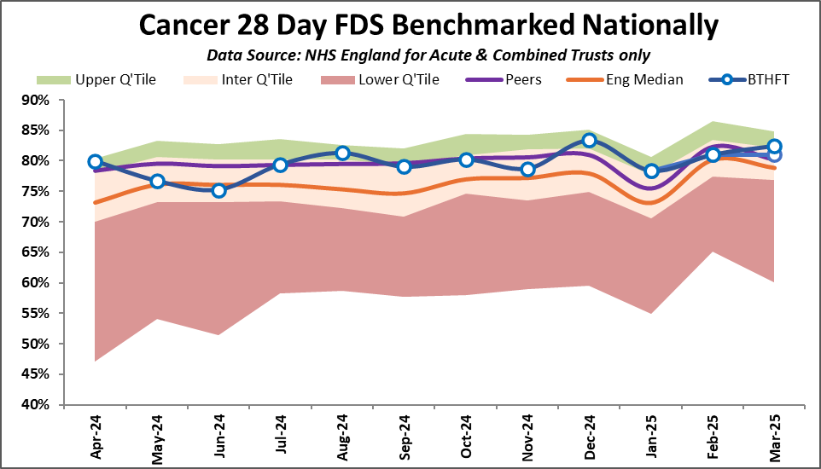
Cancer Two Week Wait
Patients referred to us on Fast Track pathways have received timely care during 2024/25, with the majority (over 93%) continuing to receive their first appointment within 2 weeks.
One-stops clinics and ‘straight to test’ pathways have streamlined processes and improved patient experience. In Head & Neck cancer a one-stop neck lump clinic was launched which has reduced diagnostic delays for these patients. There has also been significant focus on fast-track diagnostic turnaround times within Endoscopy and Histopathology.

Slide 6
Emergency Care
In 2024/25 we strengthened the streaming model to ensure patients were seen in the most appropriate setting. This built on our Urgent Treatment Centre (UTC) and increased use of the Ambulatory Emergency Care Unit (AECU), which supports reduced demand on the Emergency Department (ED) and is preventing admission into hospital wards. However, the availability of hospital beds remains a challenge and ensuring patients are discharged from care as soon as ready remains critical to improvements in this area. We have launched an Acute Care Programme with the aim to improve patient and staff experience, patient flow and address overcrowding in ED.
We are further developing our HFAST model to facilitate timely discharge.

Slide 7
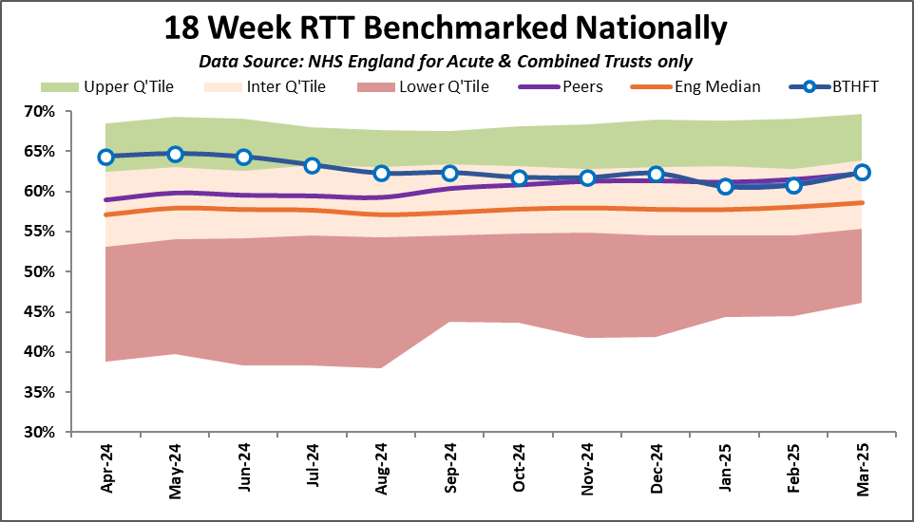
Referral to Treatment
We continued to increase both inpatient and outpatient activity.
Reducing the challenges faced with workforce supply and increasing the number of cases per theatre session has helped increase activity further and reduce waiting times for patients.

Slide 8
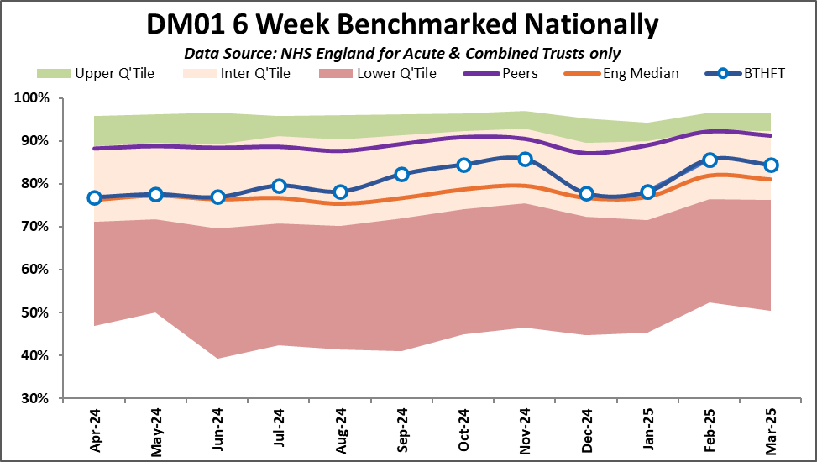
Diagnostic Waiting Times
We host a Community Diagnostic Centre (CDC) which now provides tests for all commissioned modalities. This has helped increase activity and mitigate challenges when Trust capacity has been unavailable. Demand for diagnostic tests and the need for earlier or faster access to tests has continued to grow, however with the CDC we have been able to manage this. Existing improvement plans and CDC initiatives to reform diagnostics will continue into next year when we expect to meet national targets and return to upper quartile performance.

Slide 9
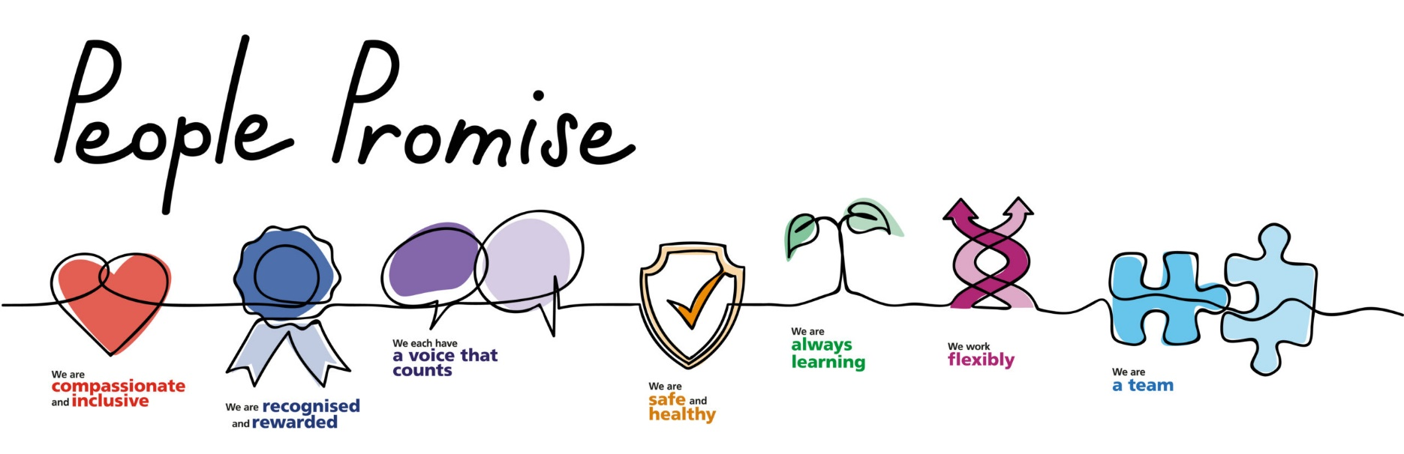
Looking after our people
We launched our People Strategy 2025-2030 which sets out how we will support, develop and empower our people to deliver outstanding care. The strategy:
Prioritises health, wellbeing and belonging for all, ensuring everyone feels included, safe and valued
Builds a great place to work: recognising and rewarding people; strong leadership and exciting career pathways
Encourages working differently: investing in digital systems; using the right skills in the right places; improving recruitment and onboarding

Slide 10
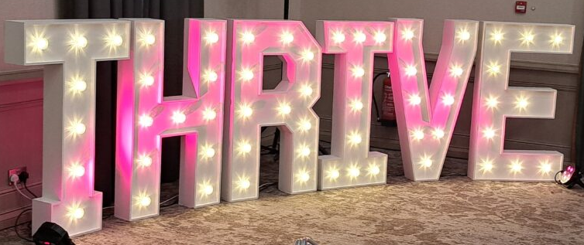
Looking after our people
With the theme of Belonging throughout the ages: Past, Present and Future, our Thrive leadership conference invited colleagues on a journey that celebrated where we’ve come from and where we’re boldly headed together.
We have also focussed on transforming staff wellbeing:
Staff gyms at BRI and St. Luke’s were transformed to better support wellbeing
We opened a new courtyard garden - with thanks to Bradford Hospitals Charity - with seats and tables, providing colleagues with a great space to relax and spend some down-time.

Slide 11
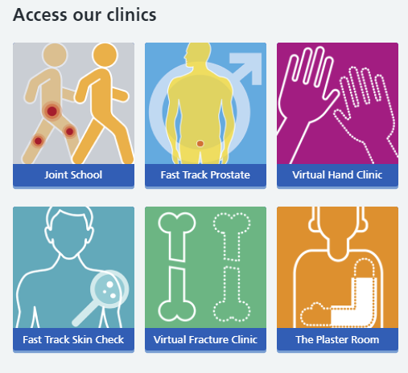
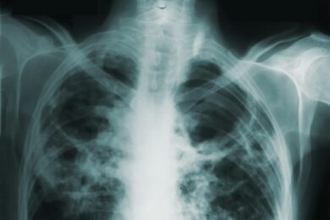
Highlights of the year
Innovation and investment in technology continue to drive improvements across our hospitals. This year we:
introduced artificial intelligence in radiology to enhance the diagnostic accuracy of chest x-rays,
expanded virtual clinics to provide care closer to home, and
adopted a new language translation app to assist staff in communicating with non-English speaking patients.

Slide 12
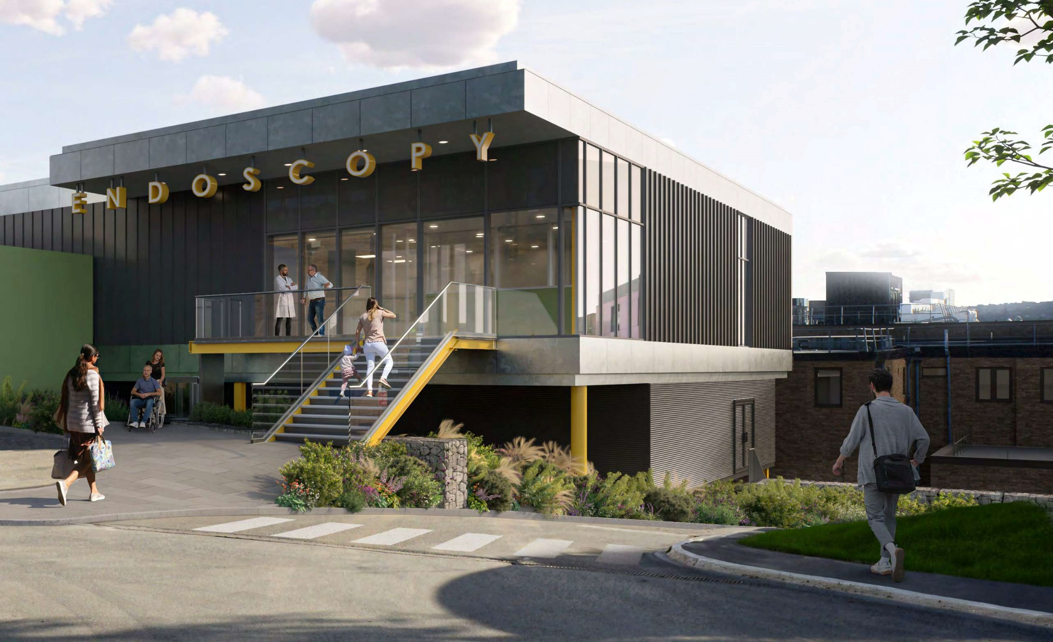
Highlights of the year
Key developments in our hospital infrastructure have also been a highlight of the year:
Our new £24m endoscopy unit has now seen its first patients.
Our new £19m day case surgical unit at St. Luke’s hospital will increase capacity for over 5,000 procedures.
Our newly refurbished and expanded Maternity Assessment Centre (MAC) opened its doors to its first patients.
The first Community Diagnostic Centre in West Yorkshire opened at Eccleshill, offering much-needed diagnostic capacity for earlier treatment in reducing health inequalities.

Slide 13
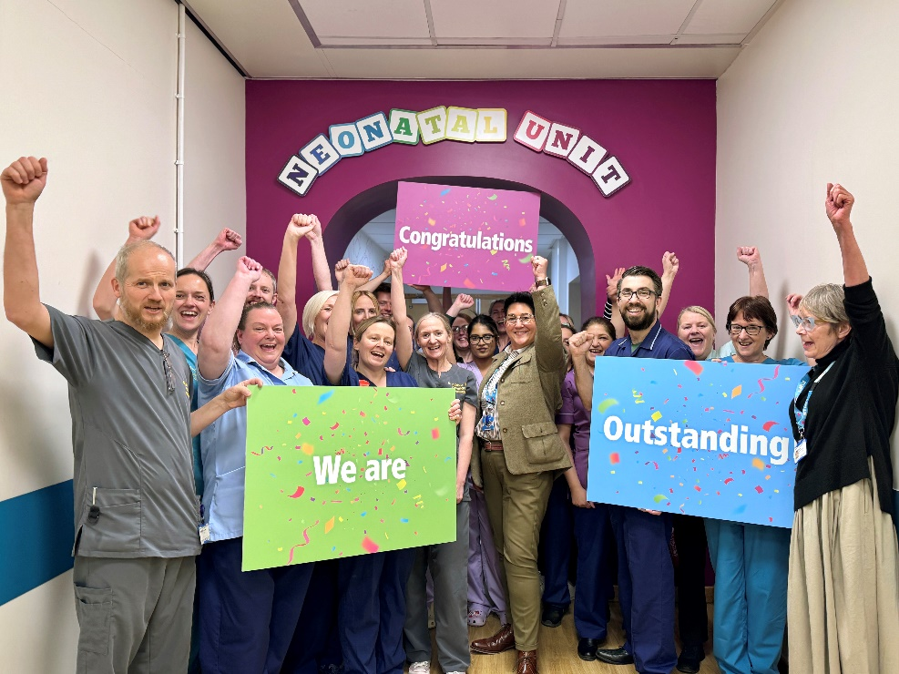
Highlights of the year
Our Neonatal Unit achieved an “Outstanding” rating from the Care Quality Commission (CQC). The CQC found the service was “performing exceptionally well”, was “exceptionally caring” and families felt valued and part of the team caring for their baby.
Our Children’s Diabetes team won a national award for the care, dedication and compassion shown to its patients. It secured the “Voice Champion of the Year” award at the annual Royal College of Paediatrics and Child Health (RCPCH) conference.

Slide 14

Highlights of the year
Extended visiting at BTHFT for Eid-Ul-Adha: For the celebration of Eid-Ul-Adha, our visiting hours were extended from 10am until 8pm to allow people enough time to visit their loved ones during the period of celebration.
We enjoyed a wonderful celebration for South Asian Heritage month. Colleagues marked the event in style with traditional costume, delicious food and beautiful henna hand painting.

Slide 15
Equality, Diversity and Inclusion achievements
With the help of our staff networks we implemented a three year strategy to promote and advance equality of opportunity, with a focus on tackling health inequalities, belonging and inclusion.
Five strategic objectives are being progressed over the next three years:
Education, Empowerment and Support
Effective Staff and Community Engagement and Involvement
Population Health Inequalities
Promoting Inclusive Behaviours
Reflective and Diverse Workforce

Slide 16

Quality Account - priorities for improvement 2024/25
Management of deteriorating patients: through our pilot of Martha’s Rule we have strengthened how deterioration is identified and escalated – introducing daily patient wellness checks and enabling earlier clinical reviews, including one case where deterioration was identified early and escalated to ICU.
Implementing 3-year plan for maternity and neonatal services: continued focus on reduction of stillbirths and inequalities; with the Trust recording its lowest ever level of stillbirths (15).

Slide 17
Quality Account - priorities for improvement 2024/25
Understanding and tackling health inequalities: significant progress made - a Health Equity Oversight Group was created and areas for improvement identified.
Embedding the Patient Safety Incident Response Plan: to improve the safety and experience of care for our patients, carers, families and staff.

Slide 18
Looking ahead
As we look ahead, we remain focused on our mission to provide outstanding care, reduce health inequalities, and improve the lives of the communities we serve. None of these achievements would have been possible without the unwavering dedication of our colleagues, and we extend our heartfelt thanks and appreciation to every one of them.

Slide 19
Thank you

