Slide 1

May 2021 EDI Update
Focus on WRES/ WDES
Kez Hayat, Head of Equality, Diversity & Inclusion
(People Academy 26th May 2021)

Slide 2
Overview
The main focus of the presentation is to provide progress and overview against Workforce Race Equality Standard indicators and Workforce Disability Equality Standard indicators; and to generate some discussion and agree some direction in terms of the proposed activity in response to this data
The presentation will also provide People Academy with a general overview in terms of the current equality, diversity & inclusion (EDI) landscape and an update on Equality, Diversity & Inclusion at BTHFT

Slide 3
Contents
The Current EDI landscape, covering local, national and regional priorities – setting the scene
Defining Equality Diversity and Inclusion – what is the difference?
Brief overview of our legal and contractual requirements – all linked to CQC inspections
Overview of the March 2021 WRES/ WDES data
Discussion – reflections and next steps on the WRES/ WDES data and proposed actions

Slide 4

Current EDI landscape
NHS People Plan – “Belonging”
The NHS must welcome all, with a culture of “belonging” and trust. We must understand, encourage and celebrate diversity in all its forms. Discrimination, violence and bullying have no place. If we do not role model this culture, then how can our patients expect to be treated equitably, and as individuals?
WY&H H&CP – “Tackling health inequalities review for BAME communities and colleagues” 4 key themes
Improving access to safe work for BAME people in West Yorkshire and Harrogate
Ensuring the Partnership’s leadership is reflective of its communities
Population planning – using information to make sure services meet different groups of people’s needs
Reducing inequalities in mental health outcomes by ethnicity
Bradford District & Craven Integrated People Plan – Integrated People Plan with focus on Inclusion and Belonging

Slide 5
Equality Act 2010 Protected Characteristics
Age
Gender
Marriage/ civil partnership
Pregnancy and maternity
Gender Reassignment
Legal protection
Disability
Race
Religion or
Belief
Sexual orientation

Slide 6
Equality Act 2010 – General Duty
A public authority must, in the exercise of its functions, have due regard to the need to:
Eliminate discrimination, harassment and victimisation
Advance equality of opportunity amongst protected characteristics
Foster good relations between protected characteristics

Slide 7

Our Contractual Obligations
Workforce Race Equality Standard (WRES)
Equality Delivery System 2 (EDS2)
Workforce Disability Equality Standard (WDES)
Accessible Information Standard (AIS)
Gender Pay Audit
All linked to CQC requirements

Slide 8
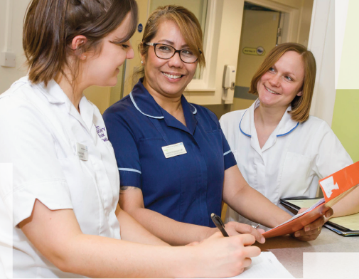
Definitions
Equality is about creating a fairer society where everyone can participate and has the same opportunity to fulfil their potential. Equality is backed by legislation designed to address unfair discrimination based on membership of a particular group
Diversity is the mosaic of people who bring a variety of backgrounds, styles, perspectives, values and beliefs as assets to the groups and organisations with whom they work and interact
Inclusion is the complete acceptance and integration of all employees regardless of diversity background that proactively leads to a sense of belonging, engagement, progression and full participation within the organisation.

Slide 9
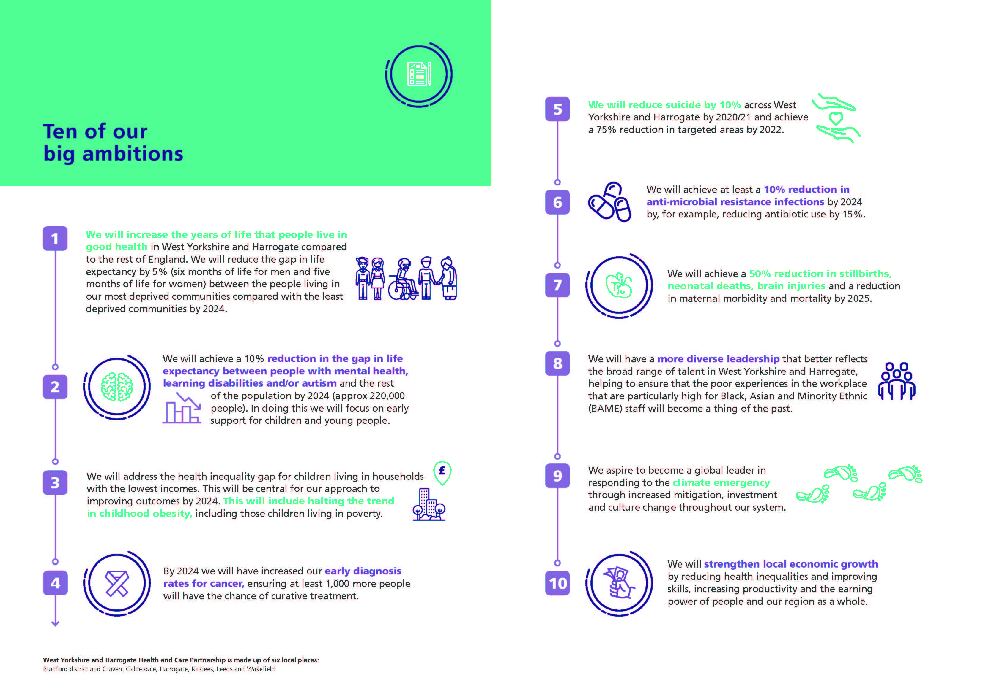
Ten of our big ambitions…

Slide 10
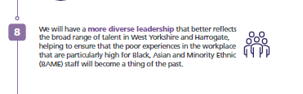
Relevant to workforce

Slide 11
Workforce race equality standard (wres)
Our Performance & Position
(March 2021 Data & Analysis)

Slide 12
BTHFT Comparison with National data

Slide 13
Indicator 1: Staffing over a 3 year period
Year | Number of Staff in overall workforce | Number of Staff in overall workforce who have declared their ethnicity | Number of Ethnic Minority Staff in overall workforce | Percentage of Ethnic Minority Staff in overall workforce
March 2019 | 6198 | 6059 | 1862 | 30.73%
March 2020 | 6240 | 6111 | 1963 | 32.11%
March 2021 | 6397 | 6273 | 2079 | 33.14%
Overall increase in Trust employee numbers
Increased % of Ethnic Minority Staff in the overall workforce. On target to achieve our ambition of 35% by 2025
Continue to be underrepresented at bands 8a+ (incl VSM) but some key appointments made. However;
Encouraging pipeline growth : increase of 27 ethnic minority appointments in clinical band 7 roles from last year

Slide 14
Indicator 2: Likelihood of appointment from shortlisting
Year | Relative likelihood of staff being appointed from shortlisting across all posts
 | Number of shortlisted applicants |  | Number appointed from shortlisting |  | Ratio appointed/ shortlisted (relative likelihood of appointment from shortlisting) |  | The relative likelihood of White staff being appointed compared to Ethnic Minority staff
 | White | Ethnic Minority | White | Ethnic Minority | White | Ethnic Minority | Likelihood
March 2019 | 3041 | 2662 | 896 | 596 | 29.50% | 22.40% | 1.32
March 2020 | 2894 | 2841 | 940 | 616 | 32.48% | 21.68% | 1.5
March 2021 | 2481 | 2217 | 834 | 509 | 33.62% | 22.96% | *1.5
The proportion of shortlisted applicants being appointed has risen each year across the board
Chance of being appointed from shortlisting continues to be 1.5 times higher for White applicants (no change from last year)
National position 2020: White staff are 1.61 x more likely

Slide 15
Indicator 3: Likelihood of staff entering the formal disciplinary process
Year | Relative likelihood of staff entering the formal disciplinary process, as measured by entry into a formal disciplinary investigation
 | Number of staff who are part of a formal disciplinary process (2-year rolling period) |  | Relative likelihood of Ethnic Minority staff entering the formal disciplinary process compared to White staff
 | White | Ethnic Minority
March 2019 | 99 | 48 | 1.09
March 2020 | 98 | 42 | 0.91
March 2021 | 56 | 33 | *1.19
Ethnic Minority staff were 1.19 times more likely than white staff to enter the formal disciplinary process.
Change from March 2020 when White staff were more likely
National position last year: For acute trusts this was the same at 1.19 x

Slide 16
Indicator 4: Likelihood of staff accessing non-mandatory training & CPD
Year | Relative likelihood of staff accessing non-mandatory training and CPD
March 2019 | 1.19
March 2020 | 1.22
March 2021 | 1.61
White staff are 1.61 times more likely than Ethnic Minority staff to access non-mandatory training.
The gap has increased slightly each year for the last 3 years
National Position 2020: ranging from 0.80 to 1.25

Slide 17
Indicators 5-8: Staff Survey Results
Year | For each of the four staff survey indicators, compare the outcomes of the responses for White and Ethnic Minority staff
 | Indicator 5 (Q13a) Percentage of staff experiencing harassment, bullying or abuse from patients, relatives or the public in last 12 months |  | Indicator 6 (Q13c) Percentage of staff experiencing harassment, bullying or abuse from staff in last 12 months |  | Indicator 7 (Q14) Percentage of staff believing that trust provides equal opportunities for career progression or promotion |  | Indicator 8 (Q15b) In the last 12 months have you personally experienced discrimination at work from Manager/colleague
 | White | Ethnic Minority | White | Ethnic Minority | White | Ethnic Minority | White | Ethnic Minority
March 2019 (2018 survey) | 27% | 25.5% | 15.7% | 20.2% | 87.1% | 70.5% | 5.7% | 14.3%
March 2020 (2019 survey) | 28.1% | 24.53% | 15.6% | 21.3% | 88.9% | 68.6% | 4.9% | 14.4%
March 2021 (2020 survey) | 29.6% | 30.3% | 24.8% | 26.7% | 87.7% | 70.4% | 5% | 15.7%
The staff survey data from 2020 shows there is much work to be done to address issues of harassment & bullying and discrimination in the Trust
One positive here to note; Confidence in equality opportunities for Career Progression has increased this year for Ethnic Minority Staff (reflective of the work ongoing in this area).

Slide 18
Indicator 9: Diversity of the Trust Board
Year | Percentage difference between the organisations’ Board membership and its overall workforce disaggregated: By voting membership of the Board By executive membership of the Board
 | Voting membership of the Board |  | Executive membership of the Board
 | White | Ethnic Minority | White | Ethnic Minority
March 2019 | 76.9% | 23.1% | 100% | 0%
March 2020 | 78.6% | 21.4% | 100% | 0%
March 2021 | 64.3% | 35.7% | 88.9% | 11.1%
Voting membership of the Board: Now representative of the workforce and community we serve at 35.7%
Executive membership of the Board: Not representative of the ethnic diversity of the workforce. However;
Appointment of Chief Operating Officer from an Ethnic Minority background is a significant advancement on this indicator

Slide 19
Progress to date on WRES
Last 12 months:
We have continued to raise the profile of race equality across the Trust in partnership with our staff equality networks – increased focus on engagement
Staff networks represented at People Academy and Equality and Diversity Council – Staff voice at decision making meetings
All posts band 8a and above have a member of staff from an Ethnic Minority background as an active recruitment panel member
Co-production of Diversity and Inclusion strapline (embedding and mainstreaming diversity and inclusion in everything we do)
Two senior Ethnic Minority staff are on the WY&H BAME Fellowship and currently recruiting for the High Potential 2 Programme aimed at ‘middle managers’.
Launch of “Reach” (an external mentoring scheme) - offered 5 places to existing Ethnic Minority staff (positive feedback)

Slide 20
Progress to date on WRES
Last 12 months:
Executive Management Team – Ethnic Minority representation
Review of disciplinary process and practice under way.
Lead role in wider place based BAME engagement events - currently exploring the development of a wider Bradford & Craven District ‘Inclusion Network’ currently exploring role and remit and to offer this as part of the High Potential 2 Programme.
Lead role in the wider Public Sector Equalities Group exploring system wide initiatives on a range of EDI priorities.
Actively celebrated and promoted Black History Month and other key cultural and religious festivals across the Trust.
Review of recruitment policy and practice

Slide 21
What next for WRES
Key Themes and Actions:
Increased focus on Ethnic Minority staff in leadership roles.
Roll out a Reciprocal Mentoring scheme for all Ethnic Minority staff at band 8a and above. Developed in partnership with the Trust’s Board of Directors (postponed due to COVID-19 - to be rolled out September 2021).
Explore personal development opportunities for Band 5 upwards and consider the development of an in house Fellowship programme for bands 5-7 ethnic minority staff
Actively consider more 8a+ posts for positive action in recruitment
Increased focus on civility in the workplace and respecting difference
Co- produce training materials with our staff equality networks and their lived experiences on our approaches to anti-racism training and awareness
Analyse and explore the gap between White and Ethnic minority staff accessing non-mandatory training and the gap between White and Ethnic minority staff entering the formal disciplinary process
Consideration of changing the name of the BAME staff network following new government guidance around the term BAME

Slide 22
Workforce Disability equality standard (wdes)
Our Performance & Position
(March 2021 Data & Analysis)

Slide 23
Metric 1:Staffing over a 3 year period
Year | Number of Staff in overall workforce | Number of Staff in overall workforce who have declared whether they have a disability or not | Number of disabled Staff in overall workforce | Percentage of disabled Staff in overall workforce
March 2019 | 6198 | 5571 | 222 | 4%
March 2020 | 6240 | 5690 | 215 | 4%
March 2021 | 6397 | 5862 | 226 | 4%
The number of staff declaring a disability has increased proportionately with the growing workforce and remains constant at 4%
More survey respondents (21%) declaring a long term health condition/ disability than is recorded on ESR.

Slide 24
Metric 2: Likelihood of appointment from shortlisting
Year | Relative likelihood of non-disabled staff compared to Disabled staff being appointed from shortlisting across all posts.
 | Number of shortlisted applicants |  | Number appointed from shortlisting |  | Likelihood of appointment from shortlisting |  | The relative likelihood of non-disabled staff being appointed compared to disabled staff
 | Disabled | Non-Disabled | Disabled | Non-Disabled | Disabled | Non-Disabled | Likelihood
March 2019 | 201 | 4046 | 52 | 1444 | 26% | 36% | 1.38
March 2020 | 263 | 5489 | 57 | 1507 | 22% | 27% | 1.27
March 2021 | 279 | 4462 | 75 | 1271 | 27% | 28% | *1.06
Although non-disabled applicants are still 1.06 times more likely to be appointed than non-disabled applicants, this gap has narrowed significantly this year from 5% to 1%

Slide 25
Metric 3: Likelihood of staff entering the formal capability process
Year | Relative likelihood of Disabled staff compared to non-disabled staff entering the formal capability process, as measured by entry into the formal capability procedure. Note: i) This metric will be based on data from a two-year rolling average of the current year and the previous year ii) This metric applies to capability on the grounds of performance and not ill health or disciplinary. This is different from Indicator 3 of the WRES, which measures entry into the disciplinary process.
 | Number of staff who are part of a formal capability process on the grounds of performance |  | Relative likelihood of disabled staff entering the formal disciplinary process compared to non-disabled staff
 | Disabled | Non-Disabled
March 2019 | 2 | 16 | 2.95
March 2020 | 2 | 20 | 2.55
March 2021 | 0 | 11 | 0.00
There were no disabled staff who entered the formal capability process during the 2-year rolling period April 2019 to March 2021

Slide 26
Metric 4a: Staff Survey Results
Year | National NHS Staff Survey Metrics For each of the following four Staff Survey Metrics, compare the responses for both Disabled and non-disabled staff.
 | Metric 4a (Q13a) Percentage of Disabled staff compared to non-disabled staff experiencing harassment, bullying or abuse from: patients, Service users or their relatives |  | Metric 4a (Q13b) Percentage of Disabled staff compared to non-disabled staff experiencing harassment, bullying or abuse from their manager |  | Metric 4a (Q13c) Percentage of Disabled staff compared to non-disabled staff experiencing harassment, bullying or abuse from colleagues
 | Disabled | Non-disabled | Disabled | Non-disabled | Disabled | Non-disabled
March 2019 (2018 survey) | 34.3% | 25.1% | 19.4% | 10.1% | 21.1% | 15.7%
March 2020 (2019 survey) | 33.9% | 25.5% | 16.7% | 9.5% | 25.3% | 15.2%
March 2021 (2020 survey) | 36.8% | 27.7% | 21.75 | 11.6% | 26.5% | 16.9%
There is an increase across the board this year in terms of harassment & bullying for both disabled and non disabled staff.
The most significant increase is for disabled staff from patients and the public

Slide 27
Metric 4b: Staff Survey Results
Year | For each of the following four Staff Survey Metrics, compare the responses for both Disabled and non-disabled staff.
 | Metric 4b (Q13a) Percentage of Disabled staff compared to non-disabled staff saying that the last time they experienced harassment, bullying or abuse at work, they or a colleague reported it.
 | Disabled | Non-disabled
March 2019 (2018 survey) | 50.7%% | 43.4%
March 2020 (2019 survey) | 51.3% | 48.4%
March 2021 (2020 survey) | 47.4% | 45.1%
47.7% of disabled staff and 45.1% of non-disabled staff who said they had experienced harassment & bullying said that they had reported it last time it occurred.

Slide 28
Metrics 5-7: Staff Survey Results
Year | For each of the following four Staff Survey Metrics, compare the responses for both Disabled and non-disabled staff.
 | Metric 5 (Q14) Percentage of Disabled staff compared to non-disabled staff believing that the Trust provides equal opportunities for career progression or promotion |  | Metric 6 (Q11e) Percentage of Disabled staff compared to non-disabled staff saying that they have felt pressure from their manager to come to work, despite not feeling well enough to perform their duties |  | Metric 7 (Q5f) Percentage of Disabled staff compared to non-disabled staff saying that they are satisfied with the extent to which their organisation values their work.
 | Disabled | Non-disabled | Disabled | Non-disabled | Disabled | Non-disabled
March 2019 (2018 survey) | 78.8% | 84.4% | 33.65% | 21.7% | 41.5% | 51.9%
March 2020 (2019 survey) | 78.8% | 85.5% | 32.7% | 18.3% | 41.7% | 55.7%
March 2021 (2020 survey) | 80.4% | 84.3% | 37.3% | 25.1% | 36.6% | 51.4%
An increase for disabled staff feeling the Trust provides equal opportunities
Disappointing results for Metrics 6 and 7
Notes:
Metric 5: The percentage of staff believing that the Trust provides equal opportunities for career progression has increased this year for disabled staff and despite a slight decline this year; remains marginally higher for non-disabled staff.
Metric 6: The percentage of staff saying that they have felt pressure to attend work when feeling unwell had decreased gradually in previous years, but has increased across the board in 2020. Sadly this may be a consequence of working during Covid-19. Having been recognised as a potential issue on the 2019 WDES return, one of our actions included the introduction of the Disability Equality Policy and provision for Disability Leave which should help to alleviate this. Training on this policy was paused as a result of Covid-19, but will continue to be rolled out during 2021/2022 and will feature in the 2021/2022 WDES action plan.
Metric 7: Despite an increase in previous years; the proportion of staff reporting that they feel the organisation values their work has decreased this year for both disabled and non-disabled staff. There continues to be less satisfaction on this metric from disabled staff and the level of satisfaction is fairly low at 36.6%. Both results are below the benchmark figure for acute trusts. The roll out of training around compassionate and inclusive leadership in 2020/2021 and initiatives such as the peer to peer sessions facilitated by the organisational development service may impact on this result for the next staff survey.

Slide 29
Metric 8: Staff Survey Results
Year | Percentage of Disabled staff saying that their employer has made adequate adjustment(s) to enable them to carry out their work.
March 2019 (2018 survey) | 68.1%
March 2020 (2019 survey) | 69.1%
March 2021 (2020 survey) | 71.6%
The percentage of staff reporting the Trust has made reasonable adjustments has increased steadily over the last 3 years

Slide 30
Metric 9: Staff Survey and the engagement of disabled staff
Year | Metric 9a) The staff engagement score for Disabled staff, compared to non-disabled staff
 | Disabled | Non-disabled
March 2019 (2018 survey) | 6.8 | 7.2
March 2020 (2019 survey) | 6.8 | 7.3
March 2021 (2020 survey) | 6.6 | 7.2
 | Metric 9b) Has your Trust taken action to facilitate the voices of Disabled staff in your organisation to be heard?
 | Yes
4
A decrease in engagement, but with much engagement work taking place since the survey was issued.

Slide 31
Metric 10: Board Representation
Year | Percentage difference between the organisations’ Board membership and its overall workforce disaggregated: By voting membership of the Board By executive membership of the Board
 | Voting membership of the Board |  | Executive membership of the Board
 | Disabled | Non-disabled | Disabled | Non-disabled
March 2019 | 8% | 92% | 0% | 100%
March 2020 | 8% | 92% | 0% | 100%
March 2021 | 7% | 71% | 0% | 89%
Despite a slight decrease in disabled voting members of the board to 7% they continue to be representative of the workforce as a whole (4%)
No member of the exec team declaring a disability or long term health condition

Slide 32
Progress to date on WDES
Last 12 months:
Increased engagement with all disabled staff across the Trust due to COVID-19 and our targeted efforts in engagement.
Introduced a Disability Equality and Disability Leave Policy
Training provided to Staff Advocates around disability and reasonable adjustments so that they are better informed and empowered to support and manage staff.
Maintained level 2 of the Disability Confident Employer standard and aspiring to Level 3.
Sunflower lanyards being promoted across the Trust which promotes and raises awareness of hidden disabilities.
Co-production of Diversity and Inclusion strapline (embedding and mainstreaming diversity and inclusion in everything we do)

Slide 33
Progress to date on WDES
Last 12 months:
Launched our first ever equality, diversity & inclusion intranet page - a hub for information and guidance around all things relating to EDI.
Successfully launched the ‘Equality Census’ exercise to improve disability disclosure, including production of an FAQ booklet in both paper and electronic format.
Maintained the hate crime reporting functionality on Datix (training provided last year for staff advocates about hate crime) and continue to ensure staff reporting harassment & bullying issues via Datix are made aware of the support that is available to them.
Continue to support and host Project Search, an initiative aimed at young disabled people with learning difficulties and with the continued aim of meeting our target of employing at least a third of all graduates from the scheme.
Trust’s NED has agreed to mentor the chair of the disabled staff network
Actively celebrated International Day of Disabled People, Neurodiversity week and Disability History Month.

Slide 34
What next for WDES
Key Themes and Actions:
Continue to raise awareness and roll out diversity census exercise to improve disability declaration rates, this will be monitored regularly
Roll out the reciprocal mentoring scheme for disabled staff at Band 8a and above. Developed in partnership with the Trust’s Board of Directors (postponed due to COVID-19 - to be rolled out September 2021).
Renew and refresh the role of the Enable Staff Network, increasing its membership and supporting staff with long term health conditions (response to the staff survey results)
Enable the provision of safe spaces for open discussions around disability related topics/ Encouraging disabled colleagues to share lived experiences to effectively influence disability equality across the Trust.
Continue to roll out the training on the Disability Equality and Disability Leave policy
Continue to roll out the widely recognised sunflower lanyard scheme for both patients and staff who wish to participate.
Finalise and launch our Disability Equality video which aims to raise the profile of disability equality in the Trust and increase awareness of the support available to disabled staff.

Slide 35
Review of Recruitment & Selection Policy
Focus group with BAME network
Review of polices in other Trusts including NELFT
Reference to NHS Employers guidance ‘Inclusive recruitment’ April 2021
WRES/WDES data
Growing our own group
Feedback from recruitment teams

Slide 36
Key proposals
Mandating recruitment training for all managers with recruitment responsibilities; 3 year renewal
Review of training content from EDI perspective
Diverse panels across all recruitment activity where possible
Review of current process for inclusion of a BAME panel member on band 8a+ selection panels
Improved guidance for feedback to unsuccessful candidates

Slide 37
Civility in the Workplace – (webinar) design with ED&I as SME. Delivered by OD
Will contribute to Civility in the workplace campaign
You as an inclusive leader – Webinar – design collaboratively with ED&I. Facilitated by OD
Being Inclusive and Encouraging (New Webinar) Peer to Peer session (replaced LSC national NHSE&I but follow same format working with Airedale )
OD
Civility Campaign (on the horizon)
OD, ED&I, HR & Comms Team to support a new Behavioural framework will take a collaborative approach
ED&I
Anti-Racism Focus Groups – Designed in consultation with ED&I Themes / topics to inform the design of the webinar workshops.
Careers Matter – (in the process of being formed pathway via webinar and additional input from ED&I and HR) values, strengths, drama triangle, career plan. Design and delivery with ED&I and recruitment as SME - to support protected groups personal career plans and aspirations. Potential follow up support via coaching, capacity depending. Planning to introduce national offer for reverse mentoring.
Recruitment and Selection in design working with ED&I and recruitment to redesign webinar which includes an ED&I focus planned for June.

Slide 38
Review of Disciplinary Process
New disciplinary policy in development (working with Union colleagues).
Suspensions: reporting to the Board on a bimonthly basis.
Moving to a Just Culture approach.
A new Mediation Service.
A new management training and development programme.
Embedding Civility and Respect.
Looking After Our People work stream focusing on supporting our staff and staff wellbeing.

Slide 39
Next Steps: “The way forward”
Proactively work towards improving our performance on WRES & WDES ensuring our workforce is reflective of the communities and patients we serve across all levels of the organisation
Gender pay gap audit/ gender equality
Dedicated staff survey action plan in response to key themes identified in the result.
Renewed approach to civility & respect in the workplace – wider culture change including policy change
Work with OD to develop our approach to EDI related training with focus on creating ‘safe spaces’ for open discussions (e.g. anti-racism)
Development of an internal mediation service – Early Resolution
Continue to raise the profile of equality, diversity & inclusion across the Trust embedding EDI in everything we do

Slide 40
Next Steps: “The way forward”
Continue to develop the Equality and Diversity Council, chaired by CEO
Ensure all our staff equality networks continue to thrive in line with the national ambitions for staff networks
work to engage further with the LGBT+ and Enable staff networks, to ensure they are thriving in line with the other staff equality networks
ensure staff equality networks are actively influencing the EDI agenda, they have a voice at decision making meetings
Development of a Trust wide equality, diversity and inclusion strategy featuring a refreshed set of strategic equality objectives, in line with EDI priorities, and in co-production with staff and the wider community, accompanied by an implementation plan
Active involvement, collaboration and partnering with Bradford & Craven District partners on EDI activity utilising the ‘Act as One’ approach

Slide 41
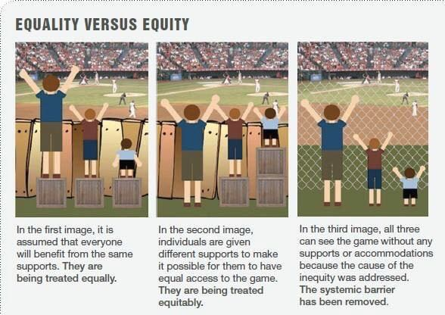
“There is nothing more unfair than the equal treatment of unequal people.” Thomas Jefferson 1743 - 1826

Slide 42

Questions & Discussion

