Slide 1


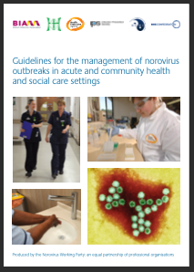

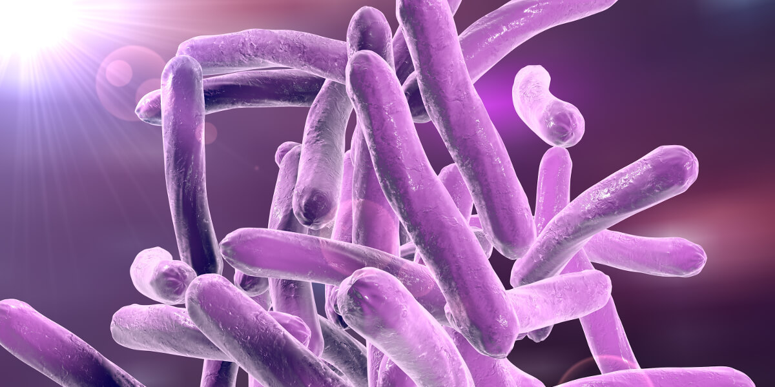
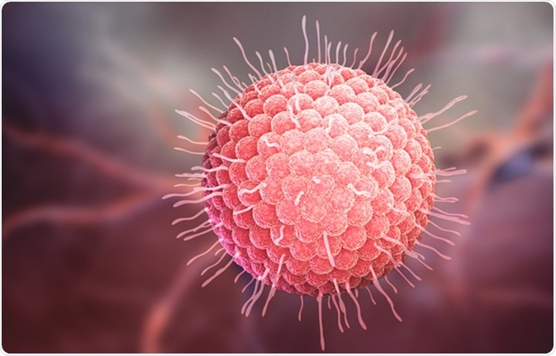
Infection Prevention and Control 3.
(Clinical Staff).
Aseptic Technique
Asepsis means without or the absence of potentially pathogenic micro-organisms (Loveday et al, 2014).
Aseptic Technique is a process/procedure used to achieve asepsis (preventing the transfer of potentially pathogenic micro-organisms to a susceptible site), (Rowley et al, 2010).
Aseptic Non-Touch Technique (ANTT) is a defined aseptic technique that many healthcare organisations use.
Loveday HP, et al (2013) epic3: National Evidence-Based Guidelines for preventing Healthcare Associated Infections in NHS Hospitals. Journal of Hospital Infection. 8651, S1-S70.
Rowley S, et al (2010) ANTT v2: An updated practice framework for aseptic technique. British Journal of Nursing (Intravenous Supplement) 19, S5-S11.
Aseptic Non-Touch Technique (ANTT)
Aseptic Non-Touch Technique (ANTT®) is a defined aseptic technique that incorporates necessary IPC measures during invasive clinical procedures. This helps to prevent the transfer of micro-organisms to ‘key/critical’ or sterile body sites from the environment, equipment or healthcare practitioners (Rowley et al, 2010).
An aseptic technique should be used during any invasive procedure that bypasses the body’s natural defences e.g. when the skin or mucous membranes are compromised or when entering a sterile body cavity such as the bladder.
Workspace needs to be clean and free from clutter.
Decontaminate hands and wear the appropriate level of PPE.
Use a designated blue tray/trolley for all ANTT procedures, make sure you decontaminate before use.
Protect your key parts and key sites
Key Sites include open wounds, including insertion and puncture sites.
Denton A, Hallam C (2020) Principles of asepsis 1: the rationale for using aseptic technique.
Nursing Times [online]; 116: 38-41.
Outbreak Management General Principles
An outbreak is classed as:
Two or more linked cases of the same illness or when the observed number of cases unaccountably exceeds the expected number. Disease poses an immediate health risk to patients/visitors/staff.
Actual/potential outbreaks identified by:
Laboratory surveillance - increase in the number of isolates of a single species.
Medical/nursing staff notice an increased incidence of a specific organism/clinical syndrome.
It is essential that clinical staff report their suspicions of an outbreak to IPCT even if investigation subsequently shows no outbreak.
Initial Investigation will include:
IPCT visit to affected area - collect information on the affected individuals (numbers, symptoms, likely source and mode of spread).
Decision on if a problem exists and the initial steps required.
Conclusion of an outbreak – Aspects to consider before concluding an incident are:
Has the source of infection been controlled?
Have sufficient practicable measures been taken to prevent recurrence of this or similar episodes?
Have adequate measures been set up to monitor affected patients and to assess the situation as a whole?
After each specific outbreak:
There may be longer-term issues which will need to be followed up. These may include training, improved guidelines, policies and procedures, capital development and recognition of defective equipment.
Public Health England Communicable Disease Management: Operational guidance (2014) https://www.gov.uk/government/uploads/system/uploads/attachment_data/file/343723/12_8_2014_CD_Outbreak_Guidance_REandCT_2__2_.pdf
COVID - !9 (SARS-CoV-2)
https://www.england.nhs.uk/coronavirus/secondary-care/
Disease is a strain of coronavirus (SARS-CoV-2) caused by zoonotic spread from animal to human initially. Coronaviruses are a family of viruses common in animals and humans. Examples include the common cold. Others cause severe disease such as Middle East Respiratory Syndrome (MERS) .
Most people with COVID-19 have recovered without the need for any specific treatment (DH 2020). In some cases COVID-19 can cause severe disease.
Based on current evidence main symptoms of COVID-19 are a cough, high temperature, loss/altered taste/smell and in severe cases, shortness of breath.
There are other symptoms of COVID-19 - refer to local/gov. guidance for up to date information.
Patients should be clinically assessed for symptoms of COVID-19 alongside establishing COVID-19 vaccination history and ensure all patients are screened/tested as per current guidelines
Placement of Covid-19 Positive/suspected Covid-19 - Immediately isolate patient in a side room or cohort bay on a designated coronavirus management ward (number of days to be isolated please refer to current guidelines
Room doors should be kept closed. Droplet/Contact Precautions. Airborne precautions for AGPs (see below) Red status
Maintain Social/Physical Distancing (SICP for Covid19)
Guidance for healthcare workers
Stay at home as per current guidelines if you develop any symptoms.
Healthcare workers need to follow current guidelines for testing.
Personal Protective Equipment (PPE)
All staff should wear PPE as per the trust guidelines.
Healthcare staff should wear the appropriate PPE whilst assessing and treating patients - see current guidelines.
For Aerosol Generating Procedures (AGP) - gowns, gloves, FFP3 masks and eye protection should be worn as single use. For further information on AGPs and PPE please see BTHFT intranet. If an AGP is performed outside an AGP designated area, staff must ensure 1 hour elapses then area is cleaned with chlorine based cleaner/equivalent
Cleaning/Clinical Waste/Linen
Covid-19 cohort bays/side rooms decontaminated with a chlorine-based agent (1:1000 ppm/equivalent), frequency as per guidelines. On transfer/discharge If patient (s) confirmed positive - infection clean followed by HPV
Linen as for infectious linen (red alginate bag and into white linen bag and labelled “risk of Infection”).
CAT B waste stream. Single orange bag. Tagged
Respiratory Viral Infections (RVI)
Always Isolate Symptomatic Patients.
Respiratory viral infections are common, responsible for the most frequent surge of patient admissions including influenza. Bacterial infections may follow an initial viral infection especially patients with compromised immune, cardiac, or pulmonary systems.
Routes of Transmission can be via contact, droplet or airborne routes
IPC management of known/suspected cases:
Nurse in a single room/cohort bay or ward on advice of the IPC team/as per source isolation policy.
The door must be kept closed.
Staff contact should be a reasonable minimum.
Hand decontamination is essential after contact with the patient/environment.
Encourage “Catch it, bin it, kill it” - dispose of used tissues into an appropriate waste receptacle/clinical waste bag.
Follow the Source Isolation Protocol Red Status.
Wear PPE in accordance to the route of transmission of the virus/risk to staff.
Linen must be treated as infected
Staff
Anyone who is suffering from persistent, unexplained respiratory symptoms, especially following foreign travel, must report to their GP and should not attend work.
Prevention measures - Influenza vaccination (recommended for all staff working within BTHFT).
Viral Gastroenteritis (VGE)
VGE is a leading cause of outbreaks of diarrhoea and vomiting in hospital and care home settings. The most common agent that causes diarrhoea and vomiting outbreaks in hospitals is Norovirus.
Actions to take
If two or more patients develop suspected viral diarrhoea and/or vomiting contact clinical site co-ordinator /liaise with the IPC team.
Initial and continued record of patients/relatives/staff affected/symptoms .
Isolate the patients within 2 hours of symptoms. Red Status
Stool samples MUST be submitted from patients with symptoms of diarrhoea.
Restricted Access sign needs to be placed outside the affected bay/ward.
Strict hand washing with soap and water for staff/patients/visitors where possible.
Encourage ALL patients to wash their hands before meals and after using the toilet. Provide hand wipes if unable to hand wash.
Staff must use contact precautions and wear single use disposable gloves and aprons for patient care to help reduce risk of cross transmission.
Limit staff/visitors attending the affected ward where possible.
If ensuite facilities are not available, identify commodes /dedicated toilets for affected patients.
Commodes/toilets MUST be thoroughly cleaned between each patient using Chlorine based cleaning solutions/products.
Staff
Any staff with symptoms should remain away from the workplace until 48 symptom free.
Tuberculosis (TB)
Tuberculosis (TB) is a disease caused by several organisms including Mycobacterium tuberculosis. TB can present in two forms- Respiratory (affecting the lungs) and elsewhere in the body e.g. nervous system. Typical symptoms of TB - extreme tiredness/fatigue, loss of appetite/weight, night sweating and fever.
Additional symptoms for pulmonary TB - increasing breathlessness and a persistent productive cough lasting more than 3 weeks. TB is treated with antibiotics, however resistance to the antibiotics used for treatment is an increasing problem: Multidrug-resistant tuberculosis (MDR TB) /Extensively drug resistant tuberculosis (XDR TB) (HPS, 2020).
See http://www.nipcm.scot.nhs.uk/a-z-pathogens/#m
Influenza (Flu)
Acute viral infection affecting the respiratory tract. Three main types or ‘genera’ of viruses that affect humans: virus A, B C.
Influenza A, is the most common and virulent and is usually the cause of flu epidemics. In temperate zones, flu is typically seasonal (most cases during the winter months).
Vulnerable groups/higher risk of complications (e.g. pneumonia) - children, pregnancy, elderly ,morbidly obese, chronic medical conditions (e.g. COPD, diabetes) and immunocompromised. An annual vaccination is available to those within these risk groups as well as healthcare workers.
Infection Prevention and Control Key Principles
Incubation Period Normally 2 to 10 weeks (immunocompromised possibly shorter). Those with latent TB infection (TB bacteria are live but inactive in the body) may never develop the TB disease and are not infectious
Period of Infectivity Whilst symptomatic plus 2 to 4 weeks after antibiotic treatment commences
Person to person transmission via inhalation of infected airborne particles– Airborne Route. Red Status
Infection Prevention and Control Key Principles
Incubation Period 1 to 3 days
Period of Infectivity 1 day before symptoms develop until 5 to 7 days whilst symptomatic
Spread via droplet and contact route. Red Status
Infectious Diseases
Infectious diseases are caused by pathogenic microorganisms e.g. bacteria, viruses, parasites and fungi. They can be spread, directly or indirectly, person to person.
For further information on other infectious diseases ( not included below) please refer to BTHFT intranet
Zoonotic diseases – These are infectious diseases of animals that can cause disease when transmitted to humans (WHO, 2018).
For further information see https://www.who.int/topics/infectious_diseases/en/
High Consequence Infectious Diseases (HCIDs)
The full list of HCIDs can be found at
https://www.gov.uk/guidance/high-consequence-infectious-diseases-hcid#hcids-in-the-uk
Included in the list are SARS and avian flu as well as Monkey Pox and other viral haemorrhagic fevers.
NB. COVID-19 is not a HCID
HCIDs are rare in the UK, tend to be sporadic and associated with recent travel to areas where the diseases is known to be endemic.
Specific infection prevention and control (IPC) measures are required for suspected and confirmed HCID cases, in all healthcare settings (specialist and non-specialist).
Varicella Voster Virus (Chicken Pox and Shingles)
Chickenpox (varicella) - acute, generalised viral disease resulting from a primary infection with the varicella-zoster virus (VZV). Generally not a serious infection. Complications can arise (encephalitis, pneumonia and secondary bacterial infection) in any individual. Chicken pox can be serious in pregnancy, immunocompromised and exposed neonates. Vaccination is available for children and adults vulnerable to complications.
The varicella-zoster virus becomes latent after initial infection and may be re-activated in later life, as herpes zoster (shingles) (HPS, 2020).
Middle Eastern Respiratory Syndrome (MERS)
MERS (also known as MERS-CoV) was identified as a new type of coronavirus that could cause a rapid onset of severe respiratory disease in people in 2012.
All cases to date have been in people who lived in or travelled to the Middle East, or who have had close contact with people who acquired the infection in the Middle East. Primary source of infection for humans is thought to be camels, the exact routes of exposure remain unknown. Many have likely acquired infection through human to human transmission.
Please refer to the BTHFT Protocol for MERS for testing and infection prevention and control precautions Red Status
Infection Prevention and Control Key Principles
Chicken Pox | Shingles
Incubation period 1-3 weeks. | Can reoccur after initial infection .
Isolation until after vesicles have crusted over. | Isolate if rash is weeping and cannot be covered or on face.
Infective 1 to 2 days before rash and up to when vesicles become dry. | Infective while rash oozes fluid.
Droplet spread Red Status . | Contact Spread Red Status.

