Slide 1
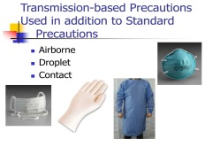
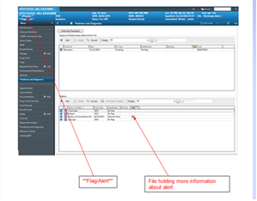
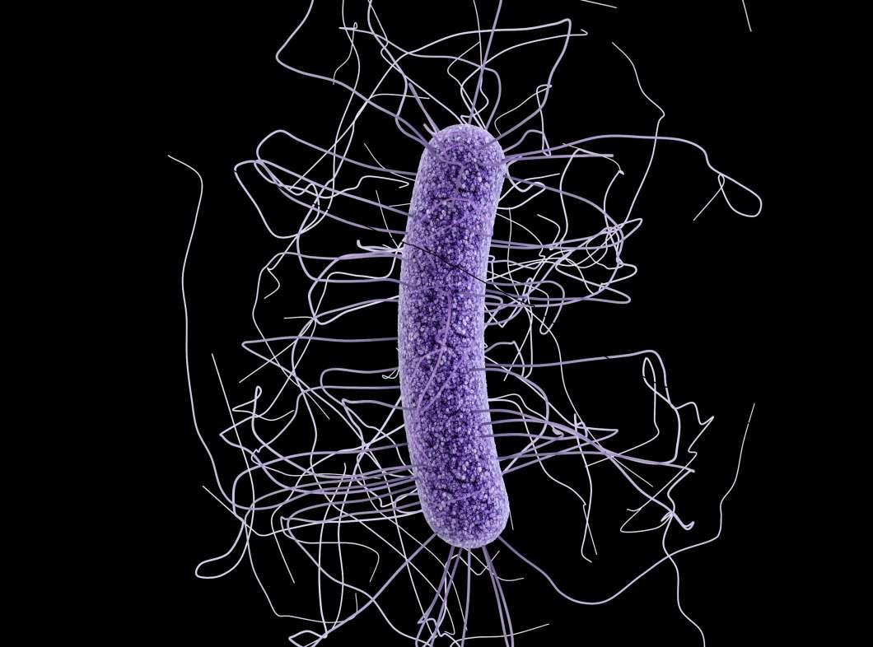
Infection Prevention and Control 2. (Clinical Staff).
Routes of Transmission
Contact Spread - Is usually via direct contact with the person and/or the immediate care environment or care equipment and is the most common form of transmission (HPS, 2020). Examples of infections and organisms that are spread by the ‘contact’ route are MRSA, E. coli, Clostridioides difficile (C. diff), Candida auris (thrush).
Droplet Spread - Large particles > 5 microns (μm) (1 μm is the equivalent to 0.001mm) from droplet transmission whereby the susceptible individual must be usually within 3 feet for the droplet (containing the infectious microorganism) to spread from the respiratory system of one individual to make contact with another individual’s respiratory tract, eyes and mouth. Examples of droplet bacteria or viruses include mumps, influenza, Neisseria meningitides (meningitis) and COVID-19.
Airborne Spread - These particles are smaller (equal or less than ≤ 5 microns/μm) and can remain suspended in air for long periods of time and are transported by air currents. They are created during breathing, talking, coughing and sneezing and can also be created by evaporation of larger droplets in conditions of low humidity. Examples of bacteria/virus spread via the airborne route include TB and chicken pox.
Transmission Based Precautions (TBP’s)
TBPs are additional measures that are undertaken when there is a known/suspected risk of an infectious agent/illness (HPS, 2020).
HPS(2020). National Infection Control Manual. Chapter 2 Transmission based precautions. Downloaded http://www.nipcm.scot.nhs.uk/chapter-2-transmission-based-precautions-tbps/
Contact Precautions
Droplet Precautions
If droplet precautions are required, contact precautions will already be in place. Additional PPE/precautions include:
Disposable apron. If an apron is insufficient for the procedure(s) being undertaken, then a fluid resistant disposable gown is required.
Fluid resistant surgical face mask with eye protection/full face visor
FFP3mask/respirator mask/power respirator hood (Person needs to be fit tested initially and fit checked every time FFP3 mask is used) if aerosol generating procedures (AGPs) are anticipated as they can produce droplets <5 microns. AGPs should be performed in well ventilated rooms and only healthcare workers that need to be present should be in the room.
AGPs include open suctioning, intubation/extubation, bronchoscopy, some dental procedures involving drills and other procedures. For further information on AGPs please see BTHFT intranet.
These are the most common type of TBPs and include:
Single Room with the door closed
PPE which consists of:
Disposable apron and Disposable gloves for contact with the patient and the environment and body fluid
Hand Hygiene before and after removal of PPE and after leaving the single room/environment
Airborne Precautions
If airborne precautions are required contact and droplet precautions will already be in place. Additional PPE/Precautions include:
Disposable gown/ Full fluid resistant disposable gown
FFP3mask/respirator mask/power hood respirator for entry into the room (Person needs to be fit tested initially and fit checked every time the mask is used if FFP3 mask)
Eye protection/Full face visor if FFP3 mask is used
Enhanced precautions in addition to TBPs may be required for novel and emerging infectious diseases such as COVID-19 and High Consequence Infectious Diseases (HCIDs) e.g. Ebola virus, MERS-CoV, SARS; avian influenza. See https://www.gov.uk/guidance/high-consequence-infectious-diseases-hcid
If enhanced/different precautions are required in addition to TBPs staff will be informed at the time ( e.g. COVID-19). Please see Banner 3 (Outbreaks and Infectious Diseases). Health Protection Scotland (HPS) also has a useful link on enhanced precautions but these may vary depending on the infectious disease. See http://www.nipcm.hps.scot.nhs.uk/media/1437/2019-02-11-aide-memoire-for-levels-of-personal-protective-equipment-ppe-for-healthcare-workers-for-patient-care.pdf .
MRSA
S. aureus resistant to the antibiotic Meticillin are termed Meticillin resistant Staphylococcus aureus (MRSA) and often require different types of antibiotic to treat them.
Patients should be screened if they:
Have a previous history of MRSA
Are admitted acutely
Are admitted electively but will require an overnight stay
Meet the moderate risk criteria
MSSA
Meticillin sensitive Staphylococcus aureus (S. aureus) [MSSA] is a bacterium that commonly colonises human skin and mucosa without causing any problems. It can also cause disease, particularly if there is an opportunity for the bacteria to enter the body, for example through broken skin or a medical procedure. Most strains of S. aureus are sensitive to the more commonly used antibiotics, and infections can be effectively treated.
Some healthcare inpatient facilities screen patients to see if they are MSSA positive prior to high risk procedures such as orthopaedic surgery and may prescribe colonisation suppression treatment if found to be positive.
MSSA can cause serious infections and be fatal
Moderate Risk Criteria
Family history of MRSA
Nursing or residential home/receiving respite care
Previous hospital in-patient admission/ hospital transfer in the last 12 months except for maternity patients unless C. section – see below
Presence of skin ulcers or wounds/severe skin disease
Presence of urinary/venous catheter/gastrostomy feeding tubes
Planned surgery resulting in implant
All patients requiring caesarean section
Health care worker
If MRSA positive
The patient requires isolation Red status
Ensure appropriate colonisation suppression treatment is prescribed
Maintain contact precautions throughout patient stay
Perform an infection clean after patient transfer/discharge.
Escherichia coli (E.coli)
E.coli are gram negative bacteria found in the intestines of humans and animals. There are many different types of E. coli, and some can live in the intestine quite harmlessly, others may cause a variety of diseases. Often spread via the faecal oral route.
They can cause a range of infections including UTI’s, and intestinal infection. E.coli bacteraemia (blood stream infection) may be caused by primary infections spreading to the blood (PHE, 2017).
There are also resistant forms of E.coli (ESBLs).
ESBL stands for extended beta lactamase (enzymes that coat the surface of the bacteria make it more resistant).
There is a National initiative to reduce number of gram-negative bacteraemia's, particularly E.coli.
Further information on gram negative blood stream infections (evidence and resources) can be found at:
https://improvement.nhs.uk/resources/gnbsi-evidence-and-further-resources/
Organisms of Specific Interest
(Alert Organisms)
Multidrug Resistant Organisms
Perform individual risk assessments on admission, check EPR for alert organism:
C Diff
MRSA
GRE / VRE
ESBL/ AMPC/ CPE
Time limited alerts for TB, Influenza etc…
Depending on the organism you will need to take appropriate IPC precautions to reduce the risk of transmission:
Isolate in a side room
Use designated equipment
Decontaminate the side room at least daily
Decontaminate equipment after each use
Infection clean the bed space on transfer/discharge
For C-diff and CPE patients the room will also need HPV on transfer/discharge
Use appropriate TBPs (contact, droplet, airborne) as well as SICPs
PHE (2017). Escherichia coli (E. coli): guidance, data and analysis
https://www.gov.uk/government/collections/escherichia-coli-e-coli-guidance-data-and-analysis
Vancomycin Resistant Enterococci (VRE)
Enterococcus bacteria are commonly found in the bowel of normal healthy people.
They also live on the skin and in the genital tract. VRE are usually harmless, but can cause infections, such as urinary tract infections (UTI), wound infections and septicaemia.
Antibiotics such as Vancomycin and Teicoplanin (Glycopeptide family of antibiotics,) are often used to treat infections caused by Enterococcus bacteria. GRE infections are resistant to these types of antibiotics.
Patients can acquire VRE:
VRE bacteria living harmlessly in the gut of a person can spread to other areas of the body where they are not normally found e. g. wound
Directly from person to person on the hands, or indirectly from contaminated equipment.
If E. coli ESBL
The patient requires isolation Amber status
Maintain contact precautions throughout patient stay
Discuss with microbiologist antibiotic treatment if required.
Perform an infection clean after patient transfer/discharge.
If VRE positive:
An alert will be on the patients EPR and ICE record
The patient must be isolated into a single side room with en-suite/ dedicated commode. Red Status
Contact Precautions
Discuss antibiotic therapy with a Consultant in Microbiology.
The referring ward must notify any facility before patient transfer/discharge so the receiving ward/hospital can implement appropriate precautionary measures
Infection clean of room must be performed after transfer/discharge.
Clostridioides difficille formerly Clostridium difficille (C.diff)
C. diff produces spores that can tolerate air, heat and resist various detergents/disinfectants and can survive for extended periods in the environment. C. diff can be transmitted via spores either by direct contact/indirect contact with a contaminated surface (toilets commodes general environment) or person.
The hands of healthcare workers can become contaminated; therefore hand hygiene is paramount for both staff and patients. Alcohol-based hand rubs are not effective in removing C. diff spores -hand washing with liquid soap and water is necessary to prevent the spread of the spores.
Carbapenem Producing Enterobacteriaceae (CPE)
CPE’s are a group of bacteria that have become extremely resistant to antibiotics including the carbapenems (e.g. Meropenem). In the UK, over the last five years, there has been a rapid increase in the incidence of colonisation and infection by these organisms. Several clusters and outbreaks have been reported. With appropriate prevention and control measures, these clusters and outbreaks can be managed effectively (PHE 2020).
On admission Assess Risk of patient being a CPE carrier:
Hospitalisation/abroad in last 12 months
Previous known case
Previous known contact
PHE (2020) Framework of actions to contain carbapenemase-producing Enterobacterales
https://assets.publishing.service.gov.uk/government/uploads/system/uploads/attachment_data/file/9235/Framework_of_actions_to_contain_CPE.pdf
If the patient has an alert on EPR for C.diff: (and admitted within 6 months of this date)
Asymptomatic (no diarrhoea) | Symptomatic with diarrhoea
Isolate the patient | Isolate the patient
The clinical team to place isolation order Amber status. | The clinical team to place isolation order Red status
Contact Precautions | Contact Precautions
 | Diarrhoea care plan
Infection Clean after discharge/transfer | Perform an Infection Clean followed by HPV clean after patient discharge/transfer if C diff this admission. Otherwise perform an infection clean.
If admitted greater than 6 months from the date of this alert and is asymptomatic for diarrhoea, the patient does not require isolation- treat as side room priority Green Code
If CPE positive:
Refer to BTHFT CPE Protocol.
The patient must be isolated into a single side room with en-suite/ dedicated commode. Red status
Contact Precautions
Discuss antibiotic therapy with a Consultant in Microbiology.
The referring ward must notify any facility before patient transfer/discharge so the receiving ward/hospital can implement appropriate precautionary measures
HPV clean of the room must be performed after transfer/discharge.
For all patients with active C.diff
Isolate the patient in a side room Maintain contact precautions – Red status Maintain strict stool chart Maintain strict hand hygiene with soap and water Clinical review of medication Enhanced cleaning with chlorine based clean Infection clean then HPV if symptomatic or newly diagnosed on this admission

